Slide 1
Resource Strength Dashboard
Pre Checklist
Product Name | Employee Retention Dashboard
Technical Product Manager | Muhammad Usama
SSCM ID
TFS/Jira ID
Requestor Name | Ali Shaukat
Requestors Department | Information Technology ( IT )
Requestor’s Department Head Approval (Optional)
Business Product Manager Approval (Optional)
Initiated Date | 07/25/2023
Dependent user stories
Version History
Version | Date | Author | Reviewer | Description
V 1.0 | 07/25/2023 | Umer Khalid | Muhammad Usama | Initial draft

Slide 2
Problem Statement
I Am | Resource strength Dashboard
Trying To | Develop a dashboard where management can easily review the Active resource with details in Analytic & graphical vision.
But | Currently there is no platform available where management can view detail information about employee under one dashboard.
Because | Currently there is no platform available.
Which Makes me Feel | Effective and Efficient to provider all necessary details employee detail and their utilization in single plate form.
Notes:
Screen shot of the Case Details with Headers will be pasted here.

Slide 3
User Story
As a Resource strength Dashboard
I want to develop a Resource strength Dashboard where management can easily review the resource details with Analytic details and graphical vision.
So that I can provide a platform where management can view detail information about employee and their utilization under one dashboard.

Slide 4

Resource Strength Dashboard
Select Practices
Designation Category
Supervisor Name
From
To
SEARCH
EXPORT
Total Active Practices
Total Revenue
Active Operation Resource
Senior Direction Operation
847
43.17 M
2370
Active Resource Average Tenure
3 7.6 Yr.
Direction Operation
Assistant Direction Operation
Lead Account Manager
Account Manager
Active Resource Average Tenure
17 5.7 Yr.
Active Resource Average Tenure
63 5.7 Yr.
Active Resource Average Tenure
163 3.7 Yr.
Active Resource Average Tenure
2124 2.9 Yr.

Slide 5
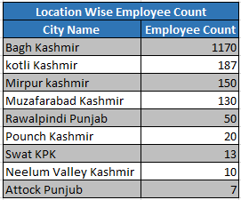
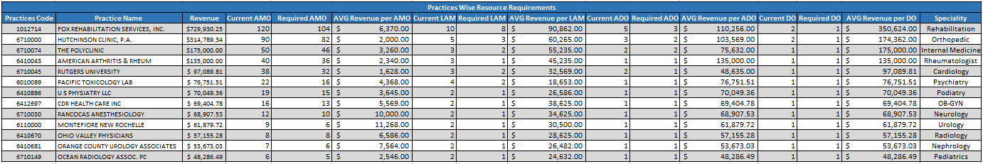
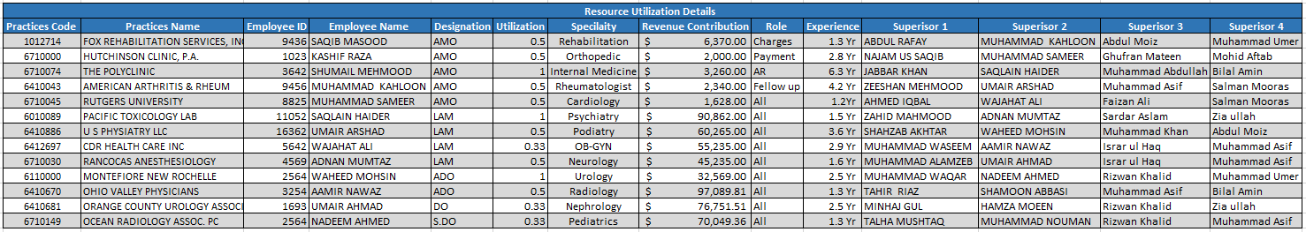

Slide 6

Acceptance Criteria
Scenario 1 : Search Criteria
Given: As a Resource strength Dashboard User
When: User is on search filter.
Then Following search criteria should be shown
Select Practices
Designation Category
Supervisor Name
From
To
Scenario 2 : Select Practice
Given: As a Resource strength Dashboard User
When: User is on search Practices filter.
Then list of all active practices should be shown in dropdown menu.

Slide 7


Scenario 3 : Selection of Designation Filter
Given: As a As a Resource strength Dashboard User
When: user want to select designation through filter.
Then Following designation of operation department should be shown in Drop down menu
All
Account Manager
Lead Account Manager
Assistant Director Operation
Director Operation
Senior Director Operation
Note: Rest of all Operation Designation Should be shown in drop down menu Employee Retention Dashboard is only for Operation Departments
Scenario 4 : Selection of Supervisor Name
Given: As a Resource strength Dashboard User
When: user want to select supervisor through filter
Then list of all active operation dept supervisor should be shown in Drop down menu
Scenario 5 : Date Selection ( From and To )
Given: As a Resource strength Dashboard User
When: user want to select date range through filter
Then : calendar view should be shown for the selection of date range in From and To filter.
Note : calendar will not allow a user to select To date ahead w.r.t current date.
Note: By Default All selection option is selected in( Select Practice , Designation category & Supervisor Name ) and data range criteria is YTD by default.

Slide 8

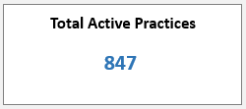
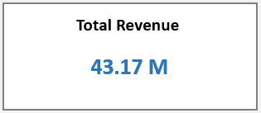
Scenario 6 : Search Button
Given: As a Resource strength Dashboard User
When: User click on search button
Then : Dashboard should reflection data according to the selected criteria in search filters
Scenario 7 : Total Active Practices
Given: As a Resource strength Dashboard User
When: User is on Total Active Practices widget.
Then : Total Active Practices is a count of all active practices.
Scenario 8 : Total Revenue
Given: As a Resource strength Dashboard User
When: User is on Total Revenue widget.
Then : Total Revenue is a sum of all active practices Revenue.

Slide 9
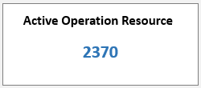
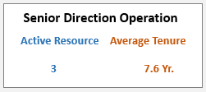
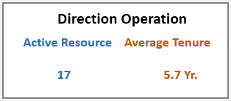
Scenario 9 : Active Operation Resource
Given: As a Resource strength Dashboard User
When: User is on Active Operation Resource widget.
Then : Active Operation Resource is a count of all present Active Operation resources till date.
Scenario 10 : Senior Director Operation
Given: As a Resource strength Dashboard User
When: User is on Senior Director Operation widget
Then : Count of all active Senior Director Operation should be shown in Active Resource
And : Average tenure is an Average of all Active Senior Director Operation tenure.
Scenario 11 : Director Operation
Given: As a Resource strength Dashboard User
When: User is on Director Operation widget
Then : Count of all active Director Operation should be shown in Active Resource
And : Average Tenure is an Average of all Active Director Operation tenure.

Slide 10
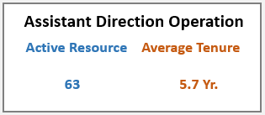
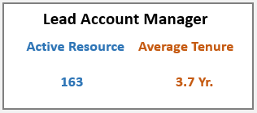
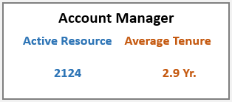
Scenario 12 : Assistant Director Operation
Given: As a Resource strength Dashboard User
When: User is on Assistant Director Operation widget
Then : Count of all active Assistant Director Operation should be shown in Active Resource.
And : Average tenure is an Average of all Active Assistant Director Operation tenure.
Scenario 13 : Lead Account Manager
Given: As a Resource strength Dashboard User
When: User is on Lead Account Manager widget
Then : Count of all active Lead Account Manager should be shown in Active Resource.
And : Average tenure is an Average of all Active Lead Account Manager tenure.
Scenario 14 : Account Manager
Given: As a Resource strength Dashboard User
When: User is on Account Manager widget
Then : Count of all active Account Manager should be shown in Active Resource.
And : Average tenure is an Average of all Active Account Manager tenure.
Calculation of Average Tenure
Formula: ( Sum of all Employee Tenure having same Designation \ Number of all employee having same Designation ).

Slide 11
Scenario 15 : Gender wise Resource Count chart
Given: As a Resource strength Dashboard User
When: User is on gender wise resource Count chart
Then : Donut chart will represent the count of Active male and female resources along with numeric value.
Scenario 16 : Designation Wise Resource chart
Given: As a Resource strength Dashboard User
When: user is on Designation wise Resource chart
Then Bar chart will represent the count of all resource as per their designation like
Account Manager
Lead Account Manager
Assistant Director Operation
Director Operation
Senior Director Operation
Note :If there any other operation Designation then it should be Added by default

Slide 12
Scenario 17 : Employee Head Count Year wise
Given: As a Resource strength Dashboard User
When: User is on Employee head count year wise chart.
Then : line chart will represent the count of total Ops employee year wise
Note : By default chart will represent data for last 6 year.
Scenario 18 : Tenure wise Employee
Given: As a Resource strength Dashboard User
When: User is on Tenure wise employee chart
Then : Graph will represent the count of all employee according to the Tenure and Designation

Slide 13
Scenario 19 : Sr.director Resource wise Employee count
Given: As a Resource strength Dashboard User
When: User is on Sr.director Resource wise Employee count pie chart
Then : Count of resource with respect to their Sr.director are shown in pie chart along with numeric value.
Scenario 20 : location wise Employee
Given: As a Resource strength Dashboard User
When: User is on Location wise Employee count widget
Then : list of all resource should be count in their permanent address City.
Note : City having huge resource count should be shown at top of list, rest of city should be shown according to their no of employee sequence.

Slide 14
Scenario 21 Resource Utilization Sheet
Given: As a Resource strength Dashboard User
When: User want to view the detail sheet of resource.
Then : Tabular widget should be shown along with following information against all Ops Resources.
Practices Code
Practice Name
Revenue ( Revenue of each Practices )
Current AMO ( No of AMO working on it)
Required AMO
AVG Revenue per AMO ( No of AMO/ Practices Revenue )
Current LAM ( No of LAM working on it)
Required LAM
AVG Revenue per LAM ( No of LAM/ Practices Revenue )
Current ADO ( No of ADO working on it)
Required ADO
AVG Revenue per ADO ( No of ADO / Practices Revenue )
Current DO ( No of DO working on it)
Required DO
AVG Revenue per DO ( No of DO / Practices Revenue )
Specialty ( Specialty of Practices )
Per AMO Revenue =( Revenue of all practices having same specialties / No of AMO working on it )
Required AMO= ( Total Practices Revenue /Per AMO Revenue )
This same formula is used against all designation.

Slide 15
Sample Sheet of Practices Wise Resource Requirements

Slide 16
Scenario 22 Resource Details Sheet
Given: As a Resource strength Dashboard User
When: User want to view the detail sheet of resource.
Then : Tabular sheet should be shown along with following information against all Ops Resources.
Practices Code
Practices Name
Employee ID
Employee Name
Designation
Utilization ( utilization is a usage of resource in different practices i.e. if resource has assign 1 practice then utilization is 1 and if
if resource has assign 2 practice then utilization is 0.5 and if resource has assign 3 practice then utilization is 0.33 against each practices ).
Specialty ( Practice Specialty )
Revenue Contribution ( Total Revenue of practices / No of All resource working on Practices )
Role ( Role Define as function area of work i.e. charges ,payment etc. for lead and above it will be consider a All )
Experience ( Joining Date to Till Date )
Superisor 1
Superisor 2
Superisor 3
Superisor 4

Slide 17
Sample Sheet of Resource Details
Scenario 22 : Export file
Given: As a Resource strength Dashboard User
When: User click on Export button
Then : Resource Utilization , Resource Details and Location Wise Employee Count should be import in excel format.

Slide 18
Post Checklist
Sr. | Items | Yes/No/Na
1 | Requestor Signed Off
3 | Technical Product Manager Signed Off
4 | Technical Team Lead Signed Off
5 | Text of the prompts are verified by marketing team
6 | Field validations are included for all fields(buttons, text boxes, drop down lists etc.)

Slide 20

Thank you

